Slide 1
How Do Different Factors Affect Sleep?
Gaston Shefa, Mahederemariam Bayleyegn Dagne, Guillermo Sanchez Lamas, Salvador Villalon Jr
Notes:
Sal

Slide 2
Project Purpose
Analyze sleep patterns to review performance and health conditions of individuals.
Notes:
Sal

Slide 3
Categories
Sedentary
Stress
Emotions
Anxiety
Researched to find a relationship between sleep and the following
Notes:
Sal

Slide 4
Data Used
FitBit Fitness Tracker Data
Dataset generated by Thirty eligible Fitbit users from 03.12.2016-05.12.2016. It includes minute-level output for physical activity, heart rate, and sleep monitoring.
Multilevel Monitoring of Activity and Sleep in Healthy People (MMASH)
Dataset provides 24 hours of continuous beat-to-beat heart data, triaxial accelerometer data, sleep quality, physical activity and psychological characteristics (i.e., anxiety status, stress events and emotions) for 22 healthy male participants.
Notes:
Sal

Slide 5

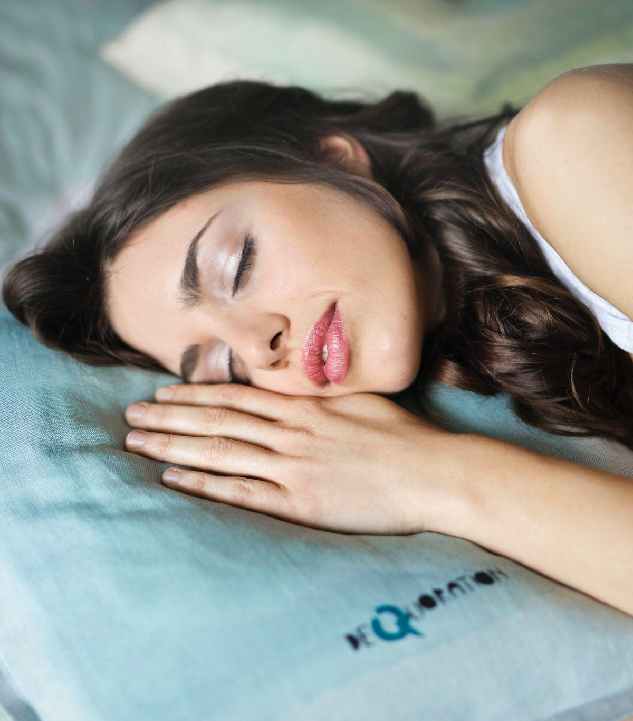
Sedentary & Sleep
Notes:
Sal

Slide 6
Preparation
For Sedentary and Sleep:
We use the data set from FitBit
The dataset contains 10K+ rows of data regarding the activities and sleep activities of about 20+ people.
To clean the data, we took the daily averages of their sleep, steps, calories, and distance walked/ran.
Notes:
Sal

Slide 7
Hypothesis Development
Question: Does being more sedentary affect the amount of sleep you get?
Hypothesis: If you are more sedentary throughout the day, you will sleep less.
Null Hypothesis: Being sedentary more than 900 minutes per day will not decrease the amount of sleep.
Alternative Hypothesis: Being sedentary more than 900 minutes per day will decrease the amount of sleep.
Significance Level: Our p values for sedentary Minutes and Total Steps are less than 0.05, so we reject the null hypothesis.
Notes:
Sal
We will reject the hypothesis if is it less than 0.05

Slide 8
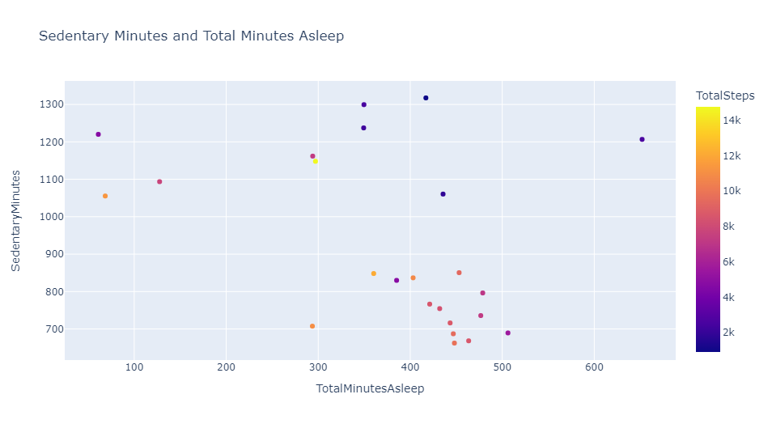
Notes:
Sal
In this chart, we are comparing Sedentary Minutes and Total Minutes Asleep and coloring the total steps for an individual. We can see individuals that there is a large group of individuals that were less sedentary, took around 10K steps and slept more hours Some outliers show how some were more sedentary and did not sleep that much

Slide 9
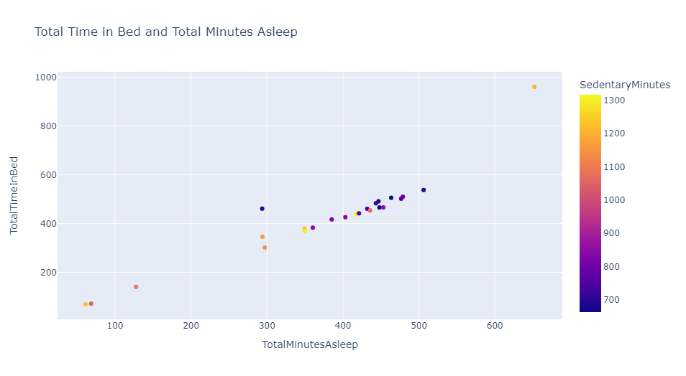
Notes:
Sal
In this chart, we are comparing Total Time In Bed and Total Minutes Asleep and coloring the total sedentary minutes.
We can that the darker color is for being less sedentary and see that there is majority of people getting between a good 400 minutes and 500 minutes of sleep and having a good total time in bed

Slide 10
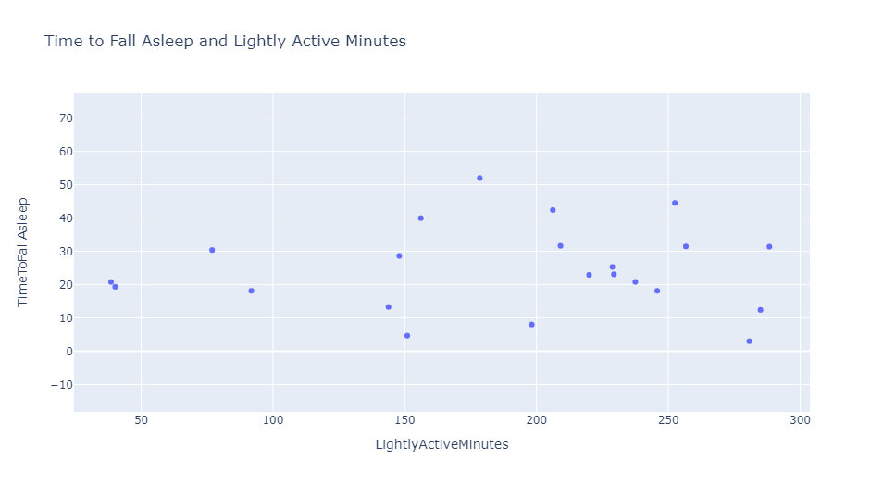
Notes:
Sal
In this chart we are comparing Time to Fall Asleep and Lightly Active Minutes The numbers vary but we see that their was a majority of users that were active but the time it took for to Fall Asleep varies some took 30 minutes like others took around 10 mins
This all depends on other factors such not relaxing before bed being stress about something before bed

Slide 11
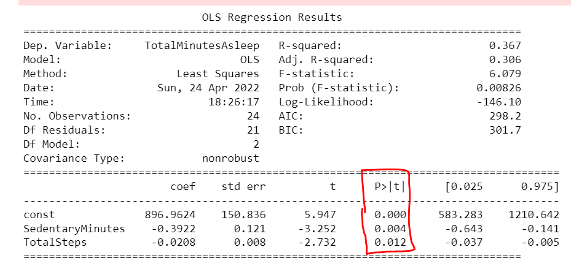
Linear Regression
Notes:
Sal

Slide 12
Analysis
Total steps walked has a 0.2 correlation with total minutes asleep
Based on the linear regression model, we reject the null hypothesis.
The less sedentary, the more sleep people got
Notes:
Sal

Slide 13

Stress & Sleep
Notes:
Gaston

Slide 14
Hypothesis Development
Question: Does waking up in the middle of the night affect your stress levels the next day?
Hypothesis: If disrupting your sleep is related to your stress levels the next day, waking up more than 10 times will result in higher stress levels the next day.
Null Hypothesis: Waking up more than 10 times will result in no increase in the amount of stress the next day.
Alternative Hypothesis: Waking up more than 10 times will result in an increase in the amount of stress the next day.
Significance Level: Our p values for Total Sleep and daily stress level are above 0.05, sufficient evidence to accept the null hypothesis.

Slide 15
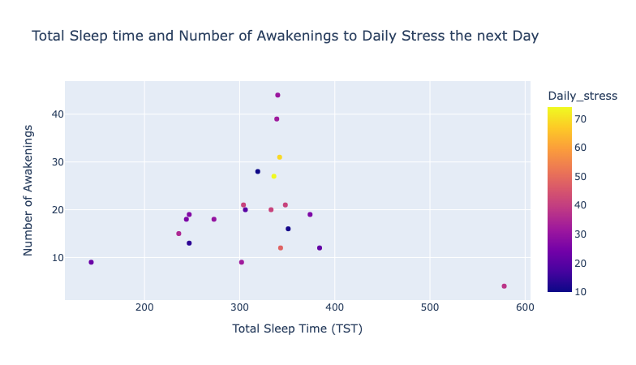

Slide 16
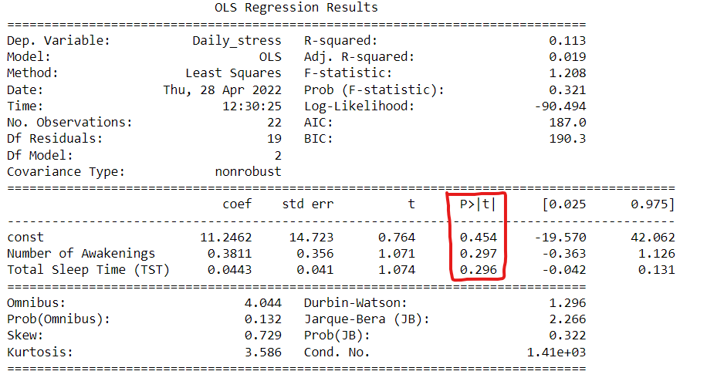
Linear Regression

Slide 17
Analysis
There is a slight correlation between these factors:
Daily Stress vs. Number of Awakenings
Daily stress and Total amount of Sleep (TST) in minutes
Based on linear regression model, number of awakenings or total sleep time do not affect daily stress levels significantly.
After sleeping more than 300 minutes, the number of awakenings range increases
Based on the P-Values we accept the null hypothesis

Slide 18

Emotions & Sleep

Slide 19
Emotions Before Sleep

Slide 20
Hypothesis Development
Negative Emotions before Sleep Hypothesis
Question: Do negative emotions before going to sleep influence the quality of our sleep?
Hypothesis: If you have negative emotions the night before going to sleep, your sleep quality will decrease (Pittsburgh score > 6).
Null Hypothesis: Having negative emotions before going to bed will result in no decrease in quality of sleep.
Alternative Hypothesis: Having negative emotion score of above 14 will result in a decrease in quality of sleep.
Significance Level: Our p value for negative emotions are above 0.05, so accept the null for negative emotions.
Positive Emotions before Sleep Hypothesis
Question: Do positive emotions before going to sleep influence the quality of our sleep?
Hypothesis: If you have positive emotions the night before going to sleep, your sleep quality will decrease (Pittsburgh score > 6).
Null Hypothesis: Having positive emotions before going to bed will result in no decrease in quality of sleep.
Alternative Hypothesis: Having positive emotion score of above 14 will result in a decrease in quality of sleep.
Significance Level: Our p value for positive emotions are above 0.05, so accept the null for negative emotions.

Slide 21
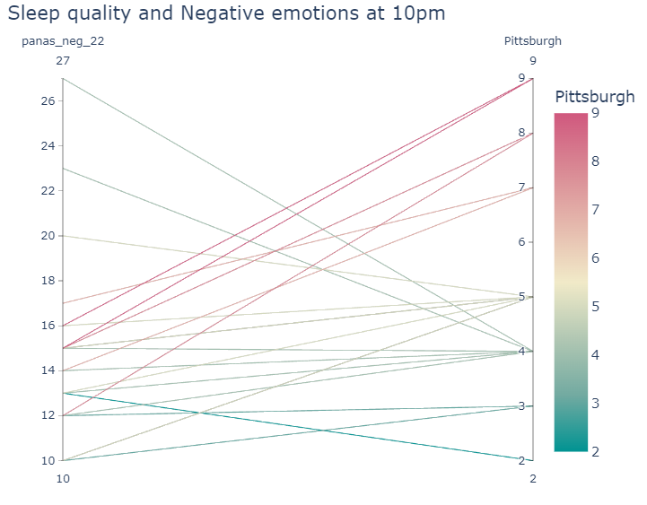

Slide 22
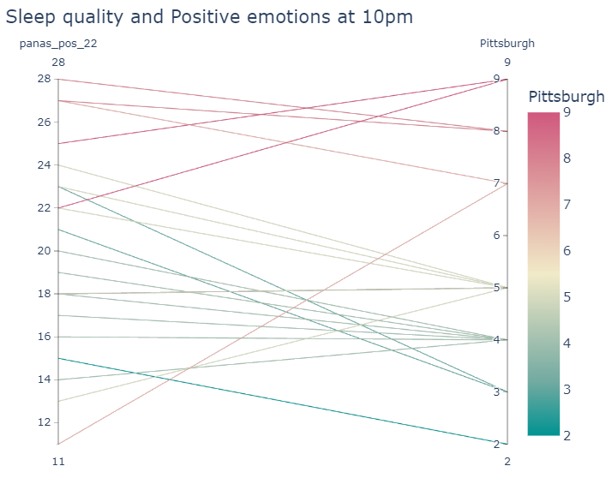

Slide 23
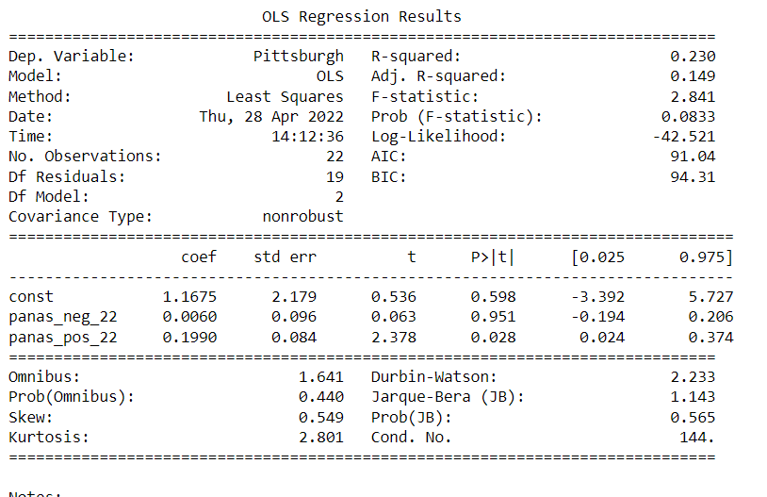
Linear Regression

Slide 24
Analysis
Before going to sleep (10pm), having lots of positive emotions impacts quality of sleep.
Before going to sleep (10pm), having lots of negative emotions does not impact quality of sleep.

Slide 25
Emotions After Sleep

Slide 26
Hypothesis Development
Negative Emotions after Sleep Hypothesis
Question: Does sleep quality affect negative emotions the morning after sleep?
Hypothesis: If your sleep quality is bad (Pittsburgh score > 6), then you will have more negative emotions (pas_neg_9+1 > 14)
Null Hypothesis: Bad sleep quality (Pittsburgh score > 6) will not affect your negative emotions.
Alternative Hypothesis: Good sleep quality (Pittsburgh score > 6) will result in more negative emotions (pas_neg_9+1 > 14)
Significance Level: Based on the linear regression model, our p value for sleep quality is below 0.05, so we reject the null for sleep quality and negative emotions the morning after.
Positive Emotions after Sleep Hypothesis
Question: Does sleep quality affect positive emotions the morning after sleep?
Hypothesis: If your sleep quality is bad (Pittsburgh score > 6), then you will have more positive emotions (pas_neg_9+1 > 14)
Null Hypothesis: Bad sleep quality (Pittsburgh score > 6) will not affect your positive emotions.
Alternative Hypothesis: Good sleep quality (Pittsburgh score > 6) will result in more positive emotions (pas_neg_9+1 > 14)
Significance Level: Based on the linear regression model, our p value for sleep quality is above 0.05, so we accept the null for sleep quality and positive emotions the morning after.

Slide 27
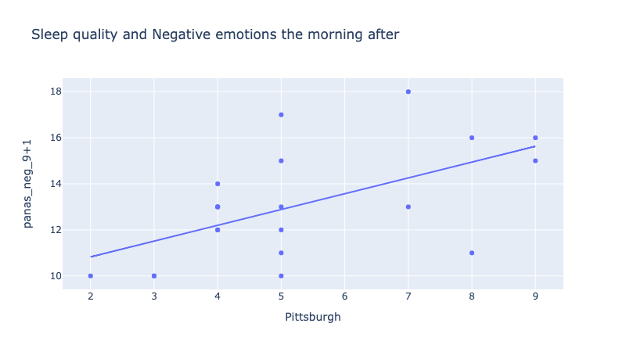

Slide 28
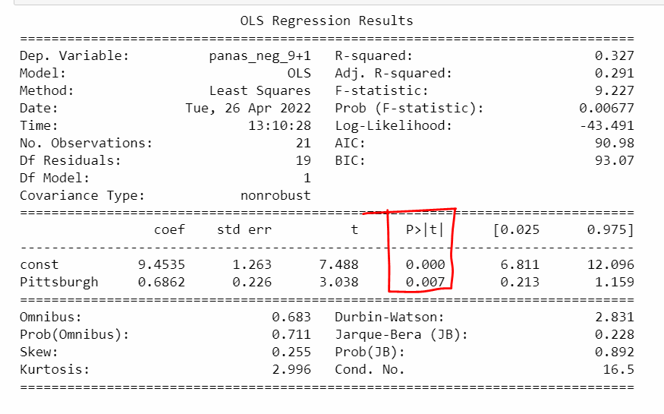
Linear Regression

Slide 29
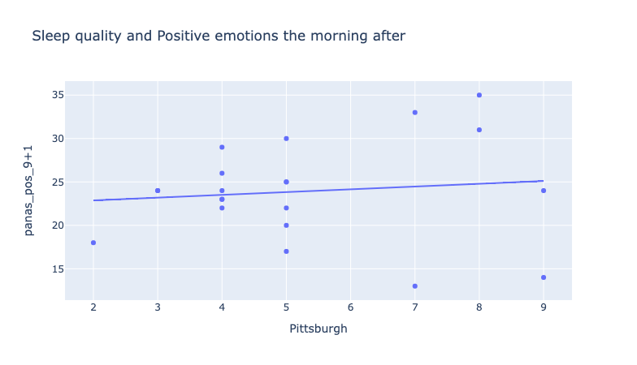

Slide 30
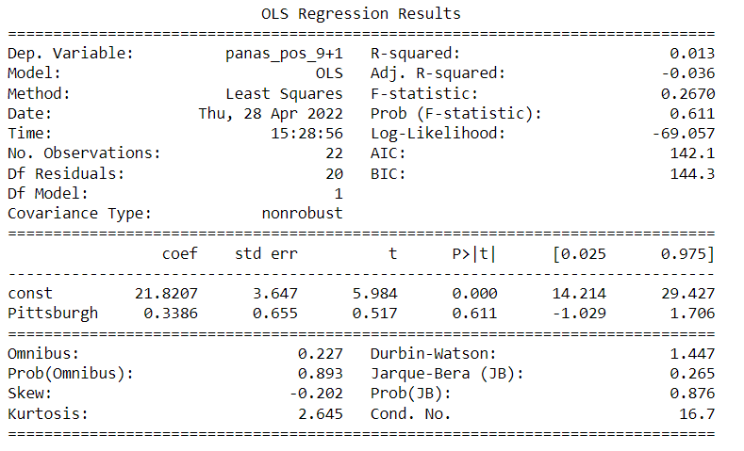
Linear Regression
`

Slide 31
Analysis
We can see an inverse relationship of positive/negative emotions and sleep quality
Positive emotions has a negative impact for sleep quality the night before
Sleep quality has a positive impact for negative emotions the morning after.

Slide 32

Anxiety & Sleep

Slide 33
Hypothesis Development
Question: Does anxiety affect the amount of sleep you get?
Hypothesis: If you are more anxious you will get less amount of sleep than when you are less anxious.
Null Hypothesis: Having an anxiety score above 50 will not affect the amount of sleep you get.
Alternative Hypothesis: Having an anxiety score above 50 will affect the amount of sleep you get.
Significance Level: 0.05

Slide 34
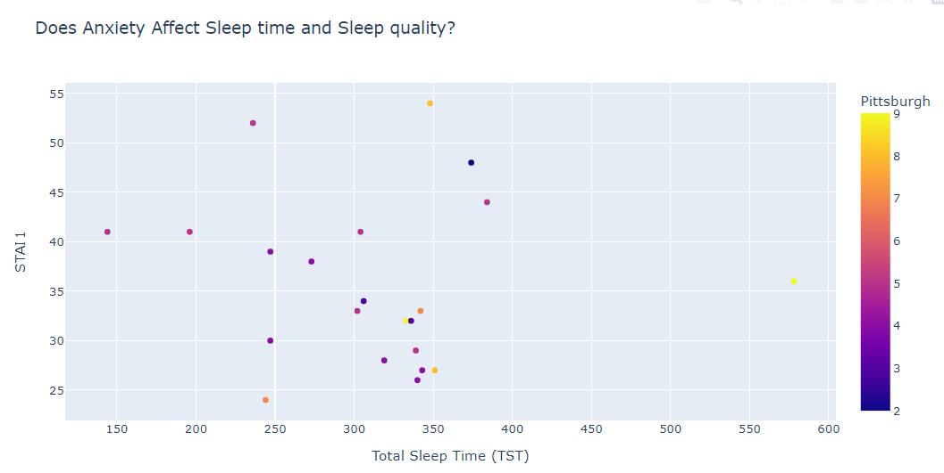

Slide 35
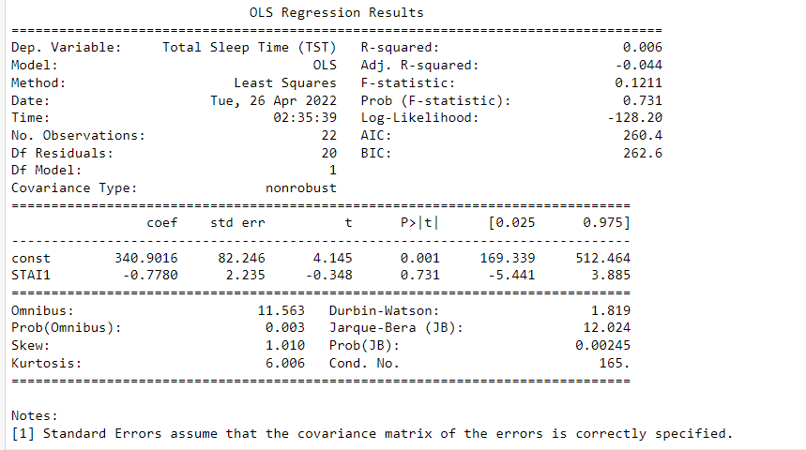
Linear Regression (Total Sleep Time and Anxiety)
Notes:
Sleep and anxiety

Slide 36
Analysis
From the scatter plot, we see the less anxious you are the more sleep you get.
Anxiety does not seem to affect sleep quality
Based on the linear regression model, we accept the null hypothesis.

Slide 37
Limitation
Dataset consisted of healthy individuals, results might be different for a broader group.
Multilevel Monitoring of Activity and Sleep in Healthy People consisted of two day datasets, a longer timeframe would make it easier to make conclusions.

Slide 38
Conclusion
Activity and Sedentary minutes affect the amount of sleep people get.
Daily Stress levels and number of awakening do not have a significant impact on the amount of sleep.
Having positive emotions before sleep has a negative effect on Sleep quality
Sleep quality affects the negative emotions we can have the next day
The level anxiety however does not affect it significantly.

Slide 39
Thank you!

